Slide 1
The Potential of the Pacific Alliance in Asia-Pacific Integration Conference on The Pacific Alliance and the Multilatinas: Strategies to Approach the Asia-Pacific EAFIT Medellin
Eduardo Pedrosa
Secretary General
Pacific Economic Cooperation Council
The views expressed here are his own and do not necessarily
reflect those of the PECC nor its members.

Slide 2
Presentation Outline
About PECC
The Concept of the Asia-Pacific
The Current Economic Context
The Trans-Pacific Trade Relationship
Contemporary Developments in the Asia-Pacific
Implications for the Pacific Alliance

Slide 3
What PECC Is
A network of individuals from academia, business and government (in private capacity) organized into 26 member committees committed to enhanced Asia-Pacific regional cooperation for mutual economic benefit
A forum for non-governmental research and dialogue on critical economic issues facing the region
A vehicle for catalytic policy ideas and informed opinion to reach policymakers and leaders in Asia-Pacific economies

Slide 4
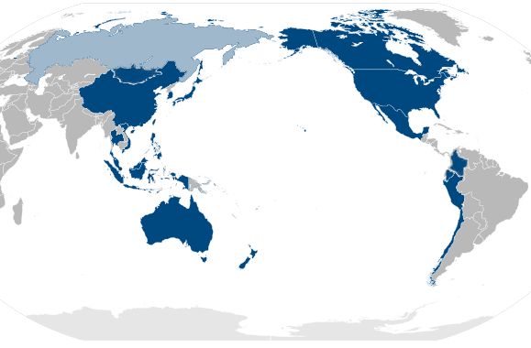
PECC’s Member Committees
Mongolia
Canada
China
Korea
Japan
USA
Hong Kong, China
Chinese Taipei
Thailand
Mexico
Vietnam
Philippines
Colombia
Malaysia
Brunei Darussalam
Singapore
Ecuador
Indonesia
Peru
Australia
New Zealand
Chile

Slide 5
The Asia-Pacific Concept

Slide 6
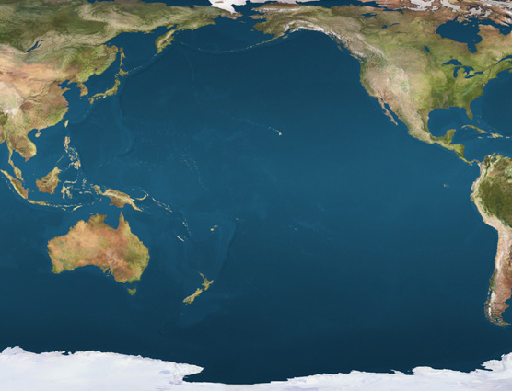
The Asia-Pacific

Slide 7
The Asia-Pacific as a region
Asia-Pacific is a construct
Traces its roots to ideas of Japanese economist Kiyoshi Kojima
Rise of Japan in 1950s and 1960s and importance of region to Japan and reaction to integration in Europe
Kojima’s proposal for a Pacific Free Trade Area led to formation of the Pacific Trade and Development Conference (PAFTAD) in late 1960s
At same time businesses in the region networking through the Pacific Basin Economic Council (PBEC) founded in the 1960s
This led to creation of Pacific Economic Cooperation Council (PECC) in 1980
And then to APEC in 1989
All of this traces its intellectual roots to Kojima’s original proposal for a Pacific Free Trade Area (PAFTA).

Slide 8
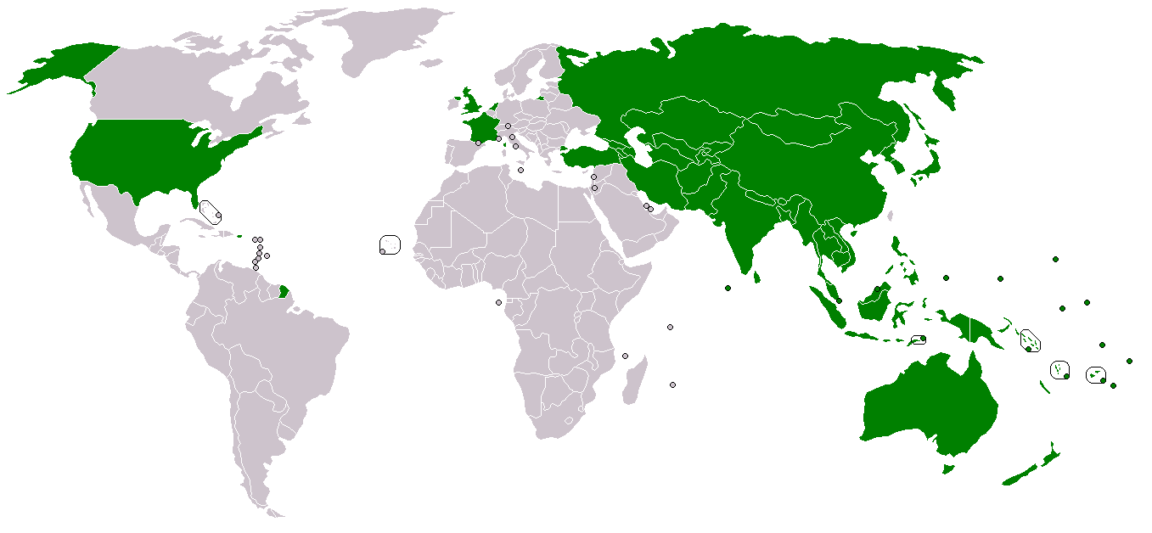
UN ESCAP Members

Slide 9
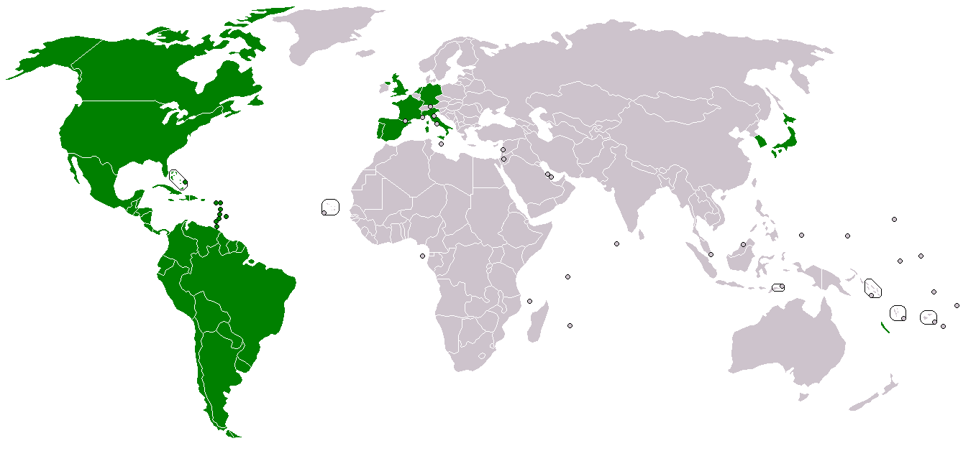
UN ECLAC Members

Slide 10
The Development of Asia-Pacific Regionalism?
Kojima
‘PAFTA’ Idea
1964
ASEAN
1967
PAFTAD
1968
PBEC
1967
ANZCERTA
1983
PECC
1980
AFTA
1993
NAFTA
1994
APEC
1989
ASEAN+1s
2005-2009
TPP
Launched 2005
RCEP
Launched 2011
FTAAP
???

Slide 11
Defining the Asia-Pacific today
All PECC members
All APEC members
All members of the East Asia Summit

Slide 12
Current Economic Context

Slide 13
Current Economic Context Regional and Global GDP Growth

Slide 14
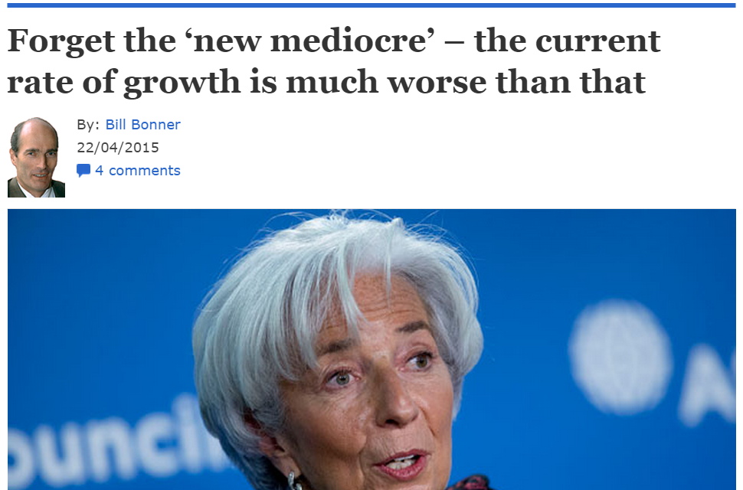
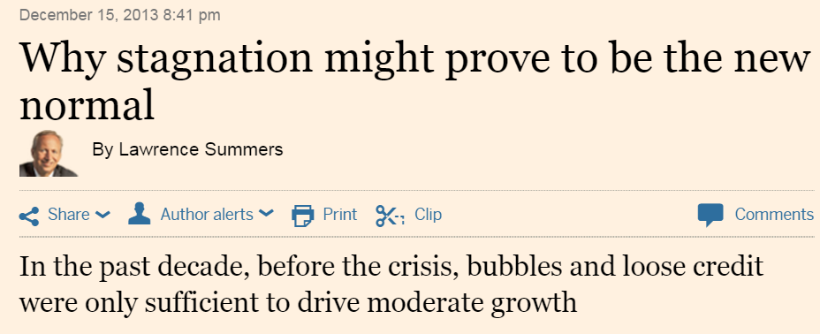
The New Normal?

Slide 15
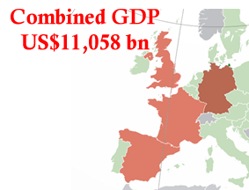
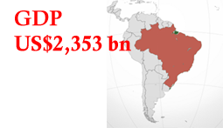
The Scale of the Region: Growth of East Asian Economies
US$13,624

Slide 16
GDP per capita: PA and ASEAN

Slide 17
Comparison of consumption expenditure

Slide 18
Trans-Pacific Trade Relationship

Slide 19
Growth in Intra-Regional Trade

Slide 20
Growth in trade among emerging Asia-Pacific economies

Slide 21
West Pacific’s Top 20 Imports and Pacific Alliance Share

Slide 22
Pacific Alliance Top 20 Exports and West Pacific’s Share

Slide 23
Western Pacific-Pacific Alliance Trade Summary
Western Pacific’s biggest imports – energy, cars, minerals (iron ore, copper)
Pacific Alliance members percentage share of Western Pacific imports low – except for copper and copper products (close to 50% of total imports)
Pacific Alliance’s biggest exports – energy, minerals (copper, gold), cars
Western Pacific’s percentage share of Pacific Alliance exports low – except for copper and copper products, some energy products, some cars, coffee
Huge POTENTIAL for transpacific trade

Slide 24
Contemporary Developments in the Asia-Pacific

Slide 25
An APEC Retrospective
2014 – 25th Anniversary of APEC
Watershed moments:
1993 – first APEC economic leaders’ meeting
1994 Bogor Goals
2004-2006 – the Free Trade Area of the Asia-Pacific
Originally adverse to creation of a trade bloc
What changed?

Slide 26
20+ years since UR Completion
20 years since UR completion
the longest stretch of time without a new global trade agreement under the GATT/WTO system.
Regional and bilateral trade agreements are now filling this vacuum.

Slide 27
RTAs Notified to the WTO

Slide 28
Developments in Regional Integration
Asian Track = RCEP
Trans-Pacific = TPP
Post Asian-crisis response to weak support from APEC and major partners
to improve the region’s capacity to deal with shocks
Accelerate progress towards APEC’s goals of free and open trade and investment.
Sustain US economic engagement in the region.
What about the Pacific Alliance?

Slide 29
Asia Pacific Trade Initiatives
Chinese Taipei
Hong Kong, China
APEC
Russia
RCEP
TPP
Japan
China
Korea
India
Canada
USA
Mexico
AEC
Brunei
Malaysia
Singapore
Vietnam
PA
Laos
Cambodia
Myanmar
Indonesia
Philippines
Thailand
Chile
Peru
Colombia
Australia
New Zealand
Papua New Guinea

Slide 30
The ASEAN Economic Community
ASEAN ECONOMIC COMMUNITY
SINGLE MARKET AND PRODCTION BASE
Free flow of goods
Free flow of services:
Free flow of investment
Freer flow of capital
Free flow of skilled labor
Priority integration sectors
Food, agriculture, and forestry
COMPETITIVE ECONOMIC REGION
Competition policy
Consumer protection Intellectual property rights Infrastructure development
Taxation
E-commerce
EQUITABLE ECONOMIC DEVELOPMENT
SME development
Initiative for ASEAN Integration
INTEGRATION INTO GLOBAL ECONOMY
Coherent approach toward external economic relations
Enhanced participation in global supply networks

Slide 31
Asian Trade Initiatives
ASEAN Free Trade Area (1992)
China-ASEAN Free Trade Agreement
Korea-ASEAN Free Trade Agreement
Japan-ASEAN Free Trade Agreement
ASEAN-ANZ Free Trade Agreement
India-ASEAN Free Trade Agreement
Regional Comprehensive Economic Partnership (2015)

Slide 32
The Trans-Pacific Partnership
‘A landmark, 21st-century trade agreement, setting a new standard for global trade and incorporating next-generation issues’
Building on original P4 agreement
commitment to the Asia – Pacific Economic Cooperation (APEC) goals and principles
12 negotiating parties, including 3 of the PA’s members
19 rounds, 9 Chief Negotiators meetings, 13 Ministerial meetings, 1 leaders’ meeting

Slide 33
PA in the Region
The Pacific Alliance as a ‘platform for economic and trade integration with a projection into the Asia-Pacific region’
Rapid progress on economic integration but projection into the Asia-Pacific, issues?
Institutionalization
MOU
Who will sign?
Attending APEC or other – who will go?

Slide 34
Moving Towards an FTAAP
“We will take concrete steps toward realization of a Free Trade Area of the Asia-Pacific (FTAAP), which is a major instrument to further APEC's regional economic integration agenda. An FTAAP should be pursued as a comprehensive free trade agreement by developing and building on ongoing regional undertakings, such as ASEAN+3, ASEAN+6, and the Trans-Pacific Partnership, among others. ”
APEC Leaders’ Statement, Yokohama 2010

Slide 35
Concrete Steps?
…we endorse the Beijing Roadmap for APEC’s Contribution to the Realization of the FTAAP .
Through the implementation of this Roadmap, we decide to accelerate our efforts on realizing the FTAAP on the basis of the conclusion of the ongoing pathways, and affirm our commitment to the eventual realization of the FTAAP as early as possible by building on ongoing regional undertakings…
We agree to launch a collective strategic study on issues related to the realization of the FTAAP…
APEC Leaders’ Statement, Beijing 2014

Slide 36
Income Gains from Regional Trade Initiatives

Slide 37
Implications for the Pacific Alliance

Slide 38
What do you think is the likelihood of success in concluding the following proposed agreements over the next 3 years?

Slide 39
ASEAN-Pacific Alliance?
September 2014: ASEAN-PA Ministerial in New York
promote cooperation between the two groupings through other frameworks, including FEALAC
May 2015: ASEAN Committee of Permanent Representatives and PA Ambassadors, agreed to explore cooperation in areas such as:
Trade and investment
Agriculture
Energy
Logistics
SMEs
Financial services and
Tourism

Slide 40
What’s next?
ASEAN has MOUs/Cooperation Agreement with: United Nations, ILO, ADB, ESCAP, EU (Dialogue Partner)
GCC
2009 Joint Vision
2009 MOU Between Secretariats
2010-2012: Action Plan
Suggestions:
Joint Expert Group?
ASEAN-BAC, PA-BAC?

Slide 41
Percent of respondents who selected ‘don’t know’ for various trade initiatives

Slide 42
Percent of respondents by sub-region who selected ‘don’t know’ for the Pacific Alliance

Slide 43
Conclusions
Global economic context extremely challenging – slower growth, protectionist sentiments
Huge opportunity for PA in growing Asia-Pacific market
Opportunity to boost growth through regional economic integration

Slide 44
Conclusions
Lessons from PA members for FTAAP
Coverage?
Treatment of next generation issues
Modalities/structure
Asia-Pacific as a ‘construct’ - concept still being defined
Integration – at a crossroads or has it gone full circle back to Kojima?
Various configurations and permutations
Opportunity for PA through engagement:
ASEAN
FTAAP

